Slide 1

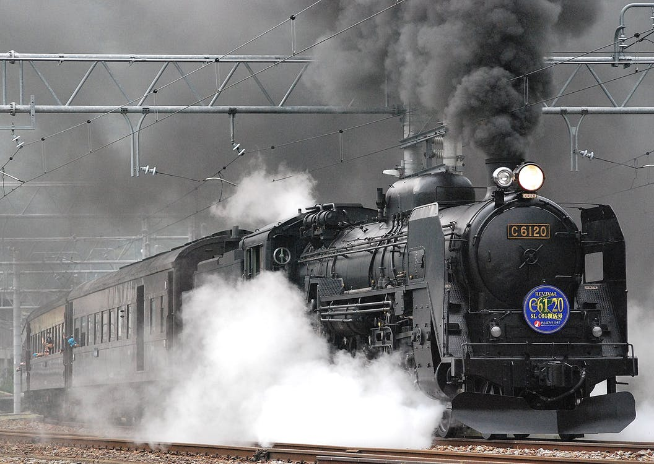




REBOUND: Defending Distributed Systems with Bounded-Time Recovery
Neeraj Gandhi, Edo Roth, Brian Sandler,
Andreas Haeberlen, Linh Thi Xuan Phan
Department of Computer and Information Science
University of Pennsylvania

Slide 2
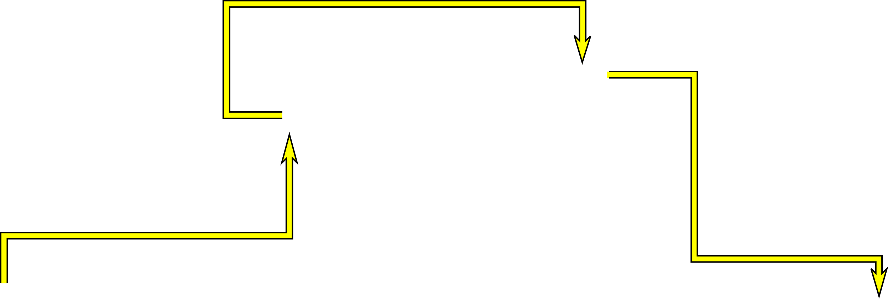
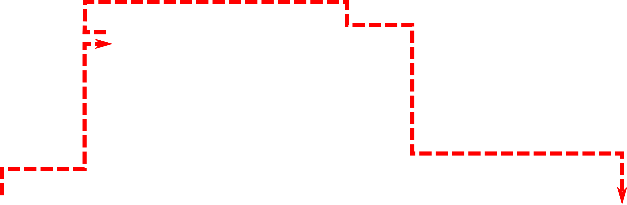




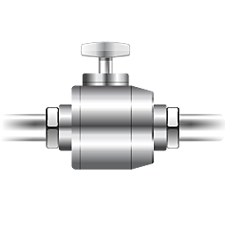





What are Cyber-Physical Systems (CPS)?
1
N₁
N₂
5
4
7
Chemical
2
N₃
N₄
3
6
8
A₃
S₁
S₂
A₁
A₂
A₄
Sensors
Control nodes
Actuators
Distributed systems using sensor data to change actuator behavior

Slide 3


CPS Can be Attacked!
1
N₁
N₂
5
4
7
Chemical
2
N₃
N₄
3
6
8
A₃
S₁
S₂
A₁
A₂
A₄
Sensors
Control nodes
Actuators
Need fault tolerance for more than crash faults

Slide 4
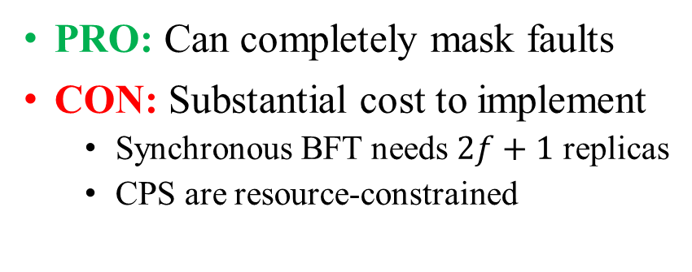
One Option Is to Use BFT
PRO: Can completely mask faults
CON: Substantial cost to implement
Synchronous BFT needs $2f+1$ replicas
CPS are resource-constrained
1
N₁
N₂
5
4
7
2
N₃
N₄
1
1
5
5
3
6
8
A₃
4
4
7
7
S₁
S₂
A₁
A₂
A₄
Sensors
Control nodes
Actuators
2
2
3
3
6
6
8
8

Slide 5
Insight: Many CPS Do Not Need Perfect Masking
N₁
N₂
2
N₃
N₄
3
We can leverage
this “recovery” period!
S₁
S₂
A₁
A₂
A₃
A₄
Sensors
Control nodes
Actuators
Correct Operation
Recoverable
Non-recoverable
Time
Fault
Catastrophe

Slide 6
How fast does recovery need to be?
DC/DC converters (STM) | 20μs
Direct torque control (ABB) | 25μs
AC/DC converters | 50μs
Electronic throttle control (Ford) | 5ms
Traction control (Ford) | 20ms
Micro-scale race cars | 40ms
Autonomous vehicle steering | 50ms
Energy-efficient building control | 500ms
Source: M. Morari. Fast model predictive control (MPC).
Timing varies by system
Many CPS have sufficiently large recovery bound times

Slide 7

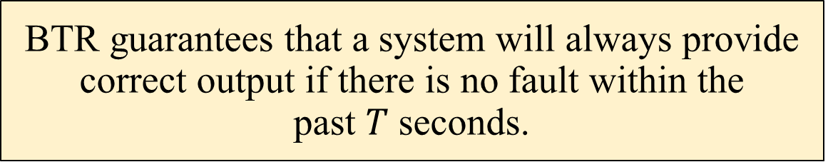
Bounded-Time Recovery from Faults
BTR guarantees that a system will always provide correct output if there is no fault within the past $T$ seconds.
$$t_{fault} + T$$
Fault
Recovered
Correct Operation
Bounded Time
Correct Operation
Recovery Period

Slide 8
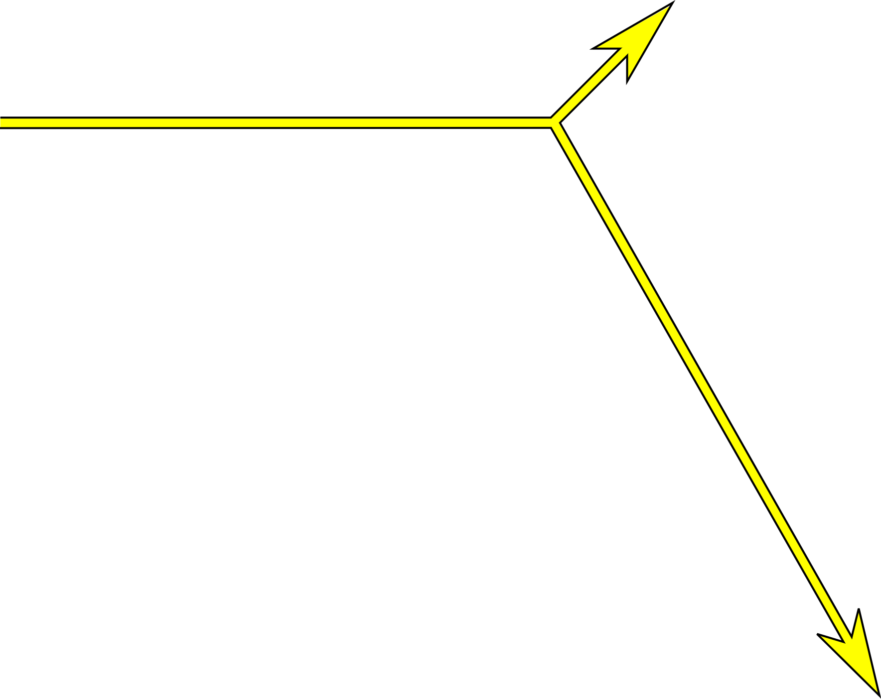



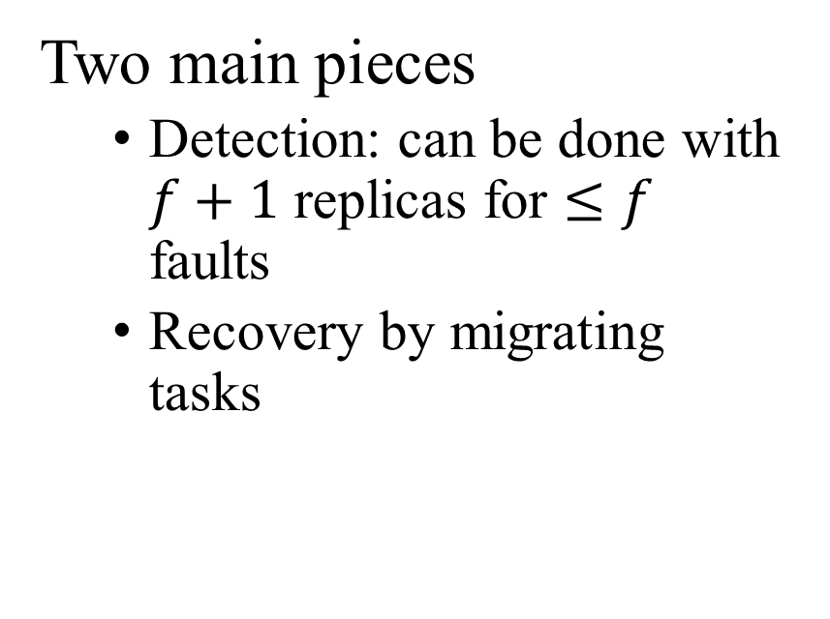
How can we guarantee BTR?
Two main pieces
Detection: can be done with $f+1$ replicas for $≤f$ faults
Recovery by migrating tasks
N₁
N₂
3
1
2
5
4
N₃
N₄
5
2
1
3
4
Example: $f=1$

Slide 9
Challenges
Identify when a fault occurs
Identify which node is faulty
How to prevent
Incorrect attribution?
False negatives?
False positives?
How to bound detection + recovery time?
…even if the adversary tries to delay detection and/or recovery
N₃ faulty!
N₁
N₂
N₃
N₄
S₁
S₂
A₁
A₂
A₃
A₄
Sensors
Control nodes
Actuators
All is well!

Slide 10
Outline
Introduction
Goal: Protect against attacks
Bounded-Time Recovery (BTR)
Approach: Detect and Recovery
Technique
Model
REBOUND
Evaluation

Slide 11

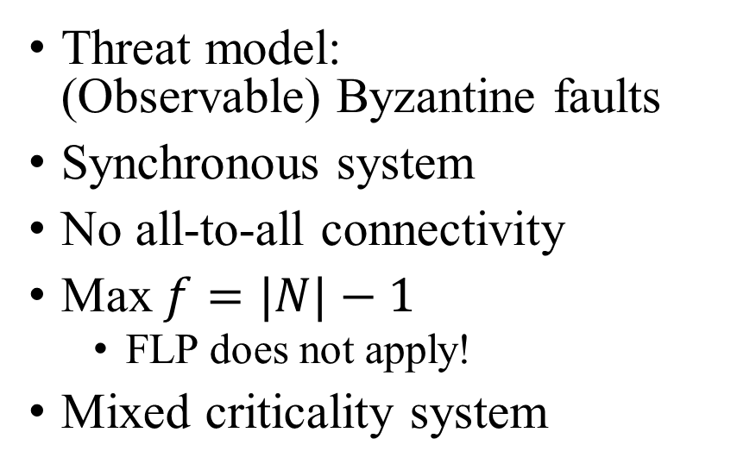
Model
Most Critical
1
Threat model: (Observable) Byzantine faults
Synchronous system
No all-to-all connectivity
Max$f=|N|−1$
FLP does not apply!
Mixed criticality system
2
3
4
5
6
7
8
Least Critical
Round 0
Round 1
Round 2
Time

Slide 12
Modes and Transitions
Drop
No Faults
7
Tree stores per-mode task allocation
Faults trigger mode transitions
Node 2 Faulty
Link 1-2 Faulty
8
…
4
Nodes 1&2 Faulty
…
…
N₁
N₂
3
N₁
N₂
N₁
N₂
1
2
5
4
6
7
8
3
N₃
N₄
5
N₃
N₄
N₃
N₄
2
1
3
3
6
4
8
7
5
1
No Faults
Node 2 Faulty
Nodes 1 & 2 Faulty

Slide 13
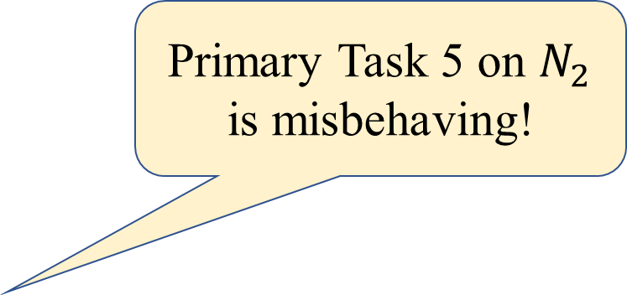

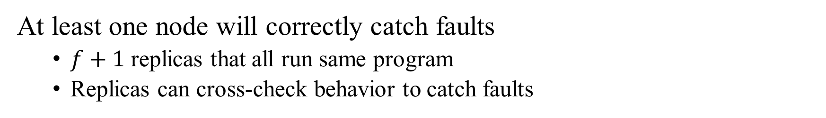
Failures trigger mode transitions
At least one node will correctly catch faults
$f+1$ replicas that all run same program
Replicas can cross-check behavior to catch faults
Primary Task 5 on $N_{2}$ is misbehaving!
N₂
Inputs
{2, 3}
Function
+
Output
5
1
2
N₁
5
3
Output
17
4
6
7
8
Cross Check
N₃
N₄
5
2
1
3
Inputs
{2, 3}
Function
+
Output
5
6
4
8
7
$$f = 1$$

Slide 14

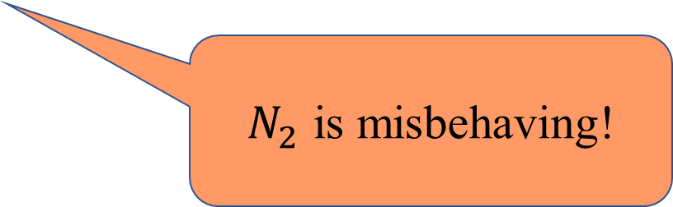
Avoid Errors by Requiring Signatures
Inputs: {2,2}
Signed: N₁
Inputs: {2,2}
Signed: N₁
Output: 4
Signed: N₂
N₁
N₂
$N_{3}$ is misbehaving!
N3 misbehaved!
Evidence:
Signed: N₂
Inputs: {2,2}
Signed: N₁
N₃
N₄
Output: 5
Signed: N₃
Output: 5
Signed: N₃
$N_{2}$ is misbehaving!
All messages are signed

Slide 15
Omission Faults
Replicas cannot verify that a message was not received by another node
Allow unilateral link fault declaration (LFD) if node is a link endpoint
LFDs are all signed
1
2

Slide 16
REBOUND: Who is at fault?
Adversaries have more complex strategies we
must address!
What happens when compromised nodes work together?
N₁
N₂
N₃
There should be either data or an LFD
received in this round
Round 0
Data
Round 1
Data
LFD(N₁→N₂)

Slide 17
REBOUND: Finding Message Omitter
Ask: What should have happened in previous round?
What should have happened in earlier rounds?
Time
Round 0
Round 1
Round 2

Slide 18
REBOUND: Require Per-Round Messages
New mode: N₄ faulty
N₁
N₂
All nodes need to know when any other node fails
Ensure attackers do not forge heartbeats
1
1
2
3
2
3
N₃
N₄
S₁
S₂
A₁
A₂
A₃
A₄
Sensors
Control nodes
Actuators
Each node must, per round, send its (signed) opinion of the system mode

Slide 19
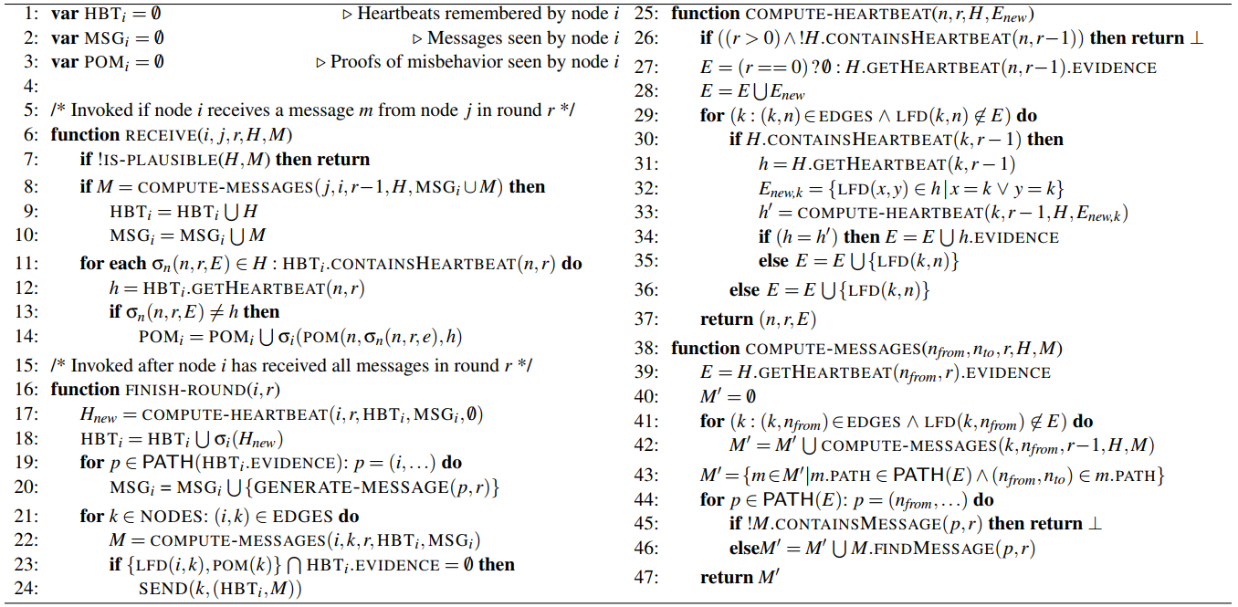
Much More in Paper + TR
Forwarding + Auditing Protocol Layers
Scheduling + Optimizations
Bus optimizations
Multisignatures for scalability
Handling edge cases to guarantee BTR
And more!

Slide 20





Multisignatures
Allow sets of nodes to sign messages
Constant size & verification time
Approach requires many messages → Message content often same
Only use for larger topologies
No faults!
No faults!
No faults!
No faults!
No faults!
No faults!
No faults!
No faults!
No faults!
N₁
N₂
N₃
N₄
N₅
N₆
No faults!
No faults!
No faults!
No faults!

Slide 21
Outline
Introduction
Goal: Protect against attacks
Bounded-Time Recovery (BTR)
Approach: Detect and Recovery
Technique
Model
REBOUND
Evaluation

Slide 22
Evaluation
List of Results
Runtime
Bandwidth/computation
Mode change timing, bandwidth consumption
Overall runtime costs
Scheduling
Scheduling overheads
BFT scheduling comparison
Case Studies
Volvo XC90
Raspberry Pi hardware experiments

Slide 23



What are the costs of REBOUND?
20
200
200
Unoptimized
Unoptimized
Unoptimized
15
Full REBOUND
150
150
Full REBOUND
Full REBOUND
10
(KB per link per round)
Bandwidth
Number of crypto ops
100
per round per node
Storage
100
(KB/node)
5
50
50
0
0
0
0
20
40
60
80
100
0
20
40
60
80
100
0
20
40
60
80
100
Number of nodes
Number of nodes
Number of nodes
Synthetic workloads in randomized network topologies
Compare REBOUND with and without multisignatures
Takeaways
Overhead is manageable
Scalability greatly improved by multisignatures!

Slide 24

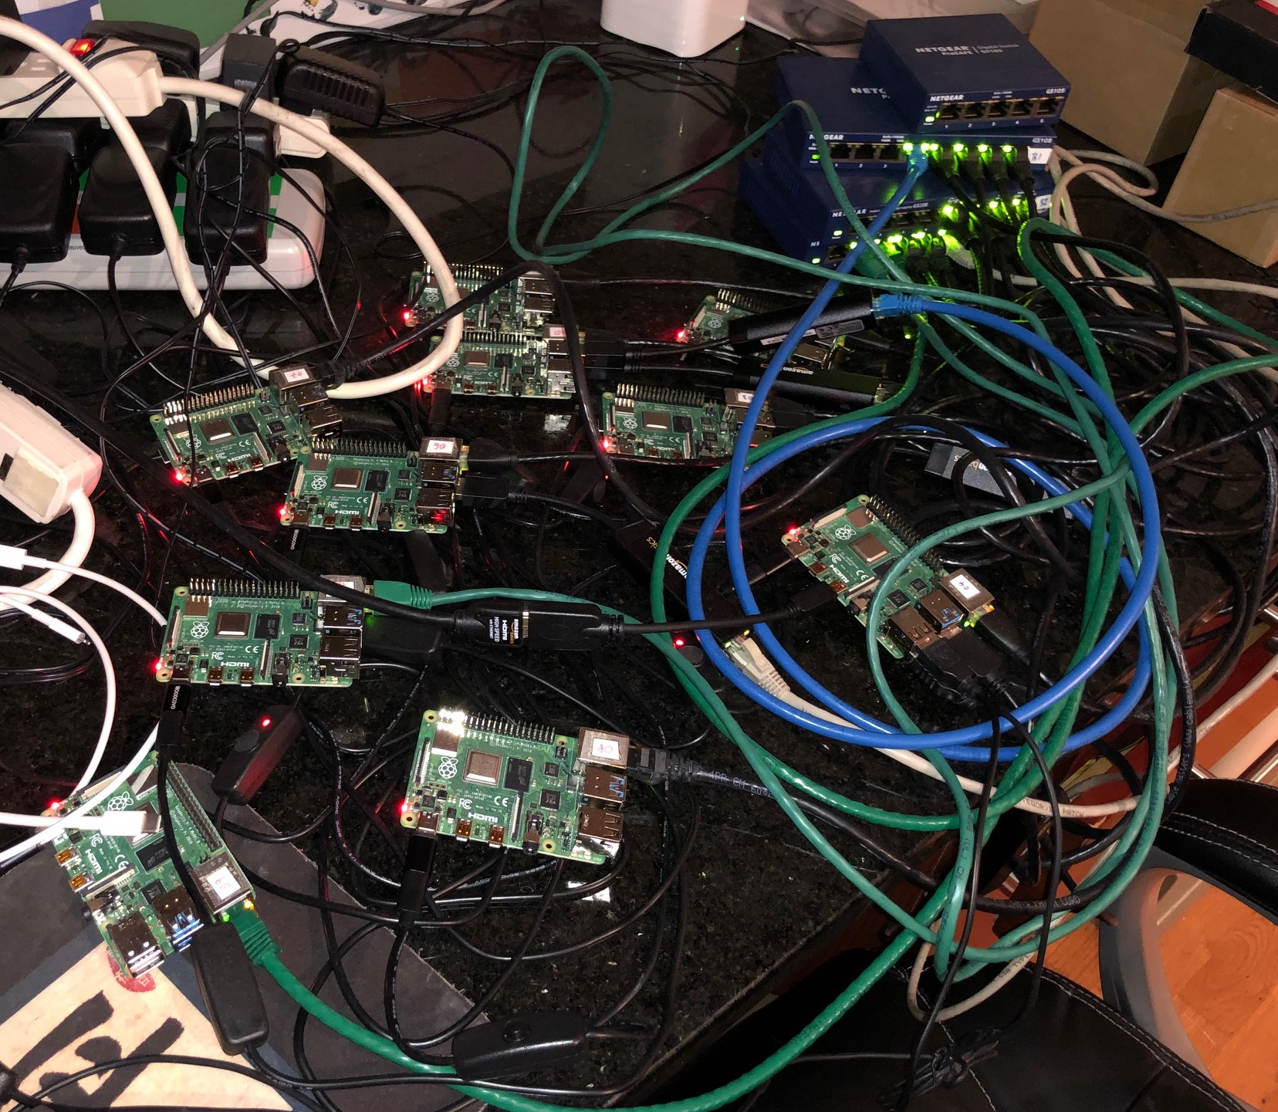
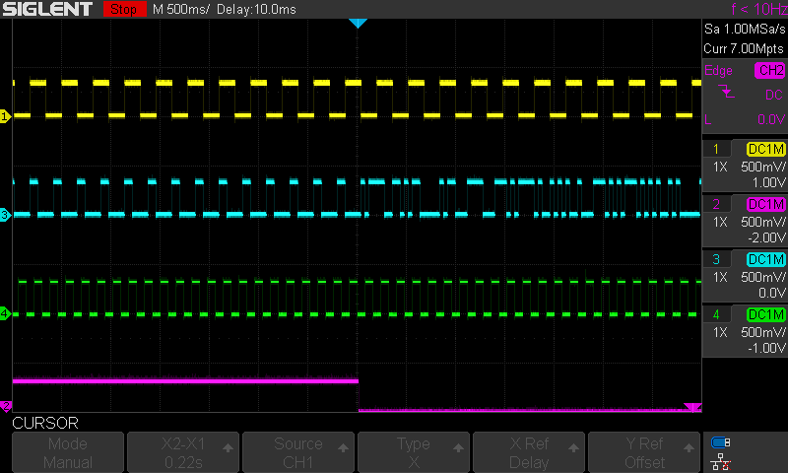






Embedded Platform: No Protection
N₂
N₁
N₄
Pressure Valve
S₁
S₂
N₃
A₁
A₂
A₃
A₄
Pressure Alarm
No Recovery Occurs
Monitor

Slide 25
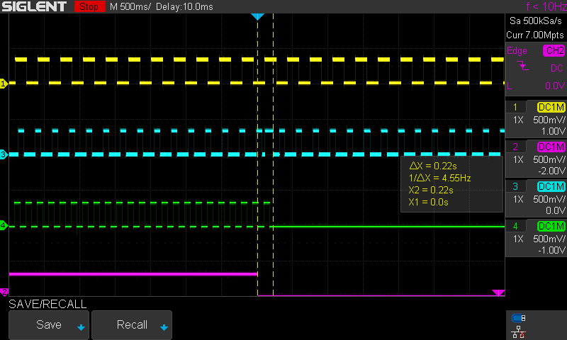
Embedded Platform: With REBOUND
Takeaway
Our approach can detect + recover quickly in a real embedded platform!
Most Critical
Pressure Valve
1
2
3
Pressure Alarm
Recovered Application
4
5
Least Critical
6
7
8
Monitor
Dropped Application
N₂
N₁
N₄
S₁
S₂
N₃
A₁
A₂
A₃
A₄

Slide 26
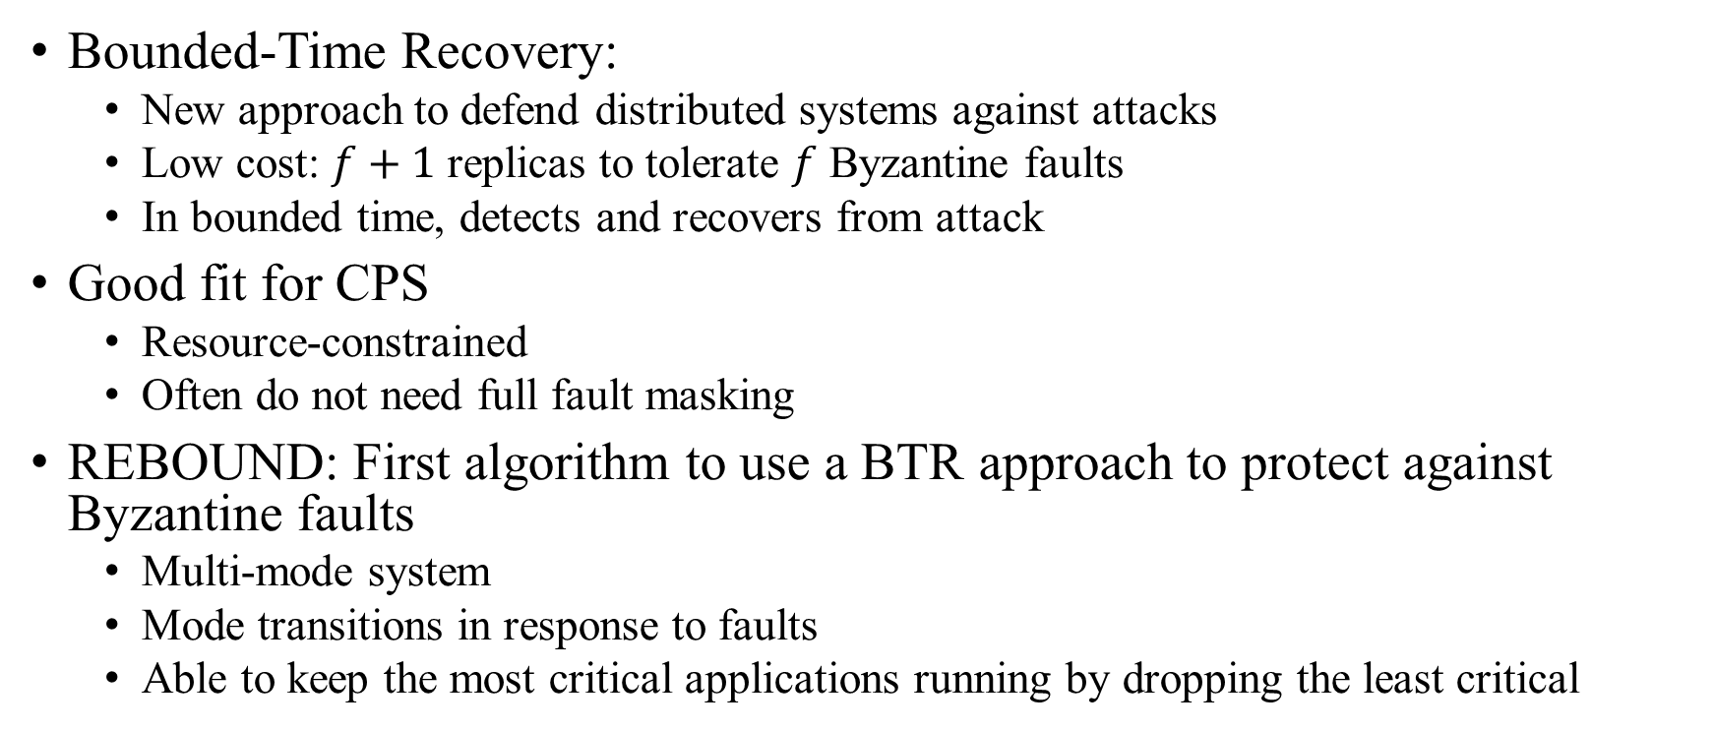
Conclusion
Bounded-Time Recovery:
New approach to defend distributed systems against attacks
Low cost: $f+1$ replicas to tolerate $f$ Byzantine faults
In bounded time, detects and recovers from attack
Good fit for CPS
Resource-constrained
Often do not need full fault masking
REBOUND: First algorithm to use a BTR approach to protect against Byzantine faults
Multi-mode system
Mode transitions in response to faults
Able to keep the most critical applications running by dropping the least critical
Thank you!

